Slide 1

Tricks to Improve Performance
AI VIETNAM
All-in-One Course
TA Hùng An

Slide 2
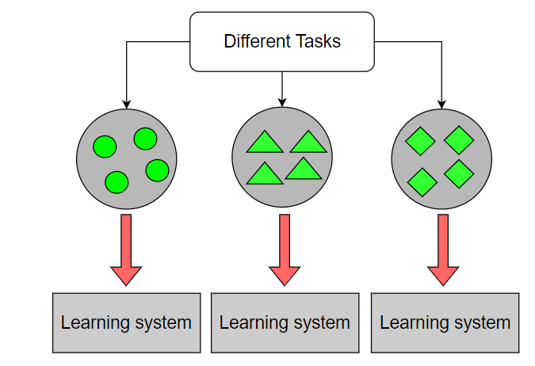
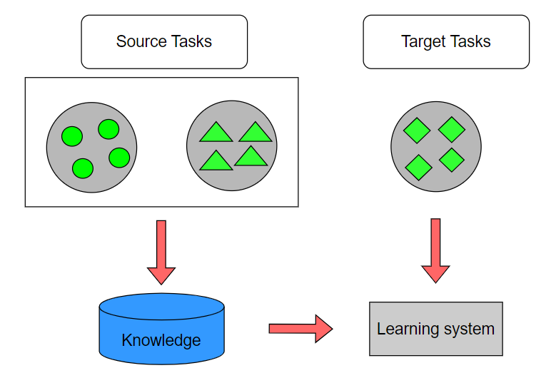
1 - Transfer Learning
AI VIETNAM
All-in-One Course
Traditional vs Transfer Learning
Traditional Machine Learning
Transfer Learning

Slide 3
1 - Transfer Learning
AI VIETNAM
All-in-One Course
Transfer Learning Types
Types | Description | Examples
Inductive | Adapt existing supervised training model on new labeled dataset | Classification, Regression
Transductive | Adapt existing supervised training model on new unlabeled dataset | Classification, Regression
Unsupervised | Adapt existing unsupervised training model on new unlabeled dataset | Clustering

Slide 4
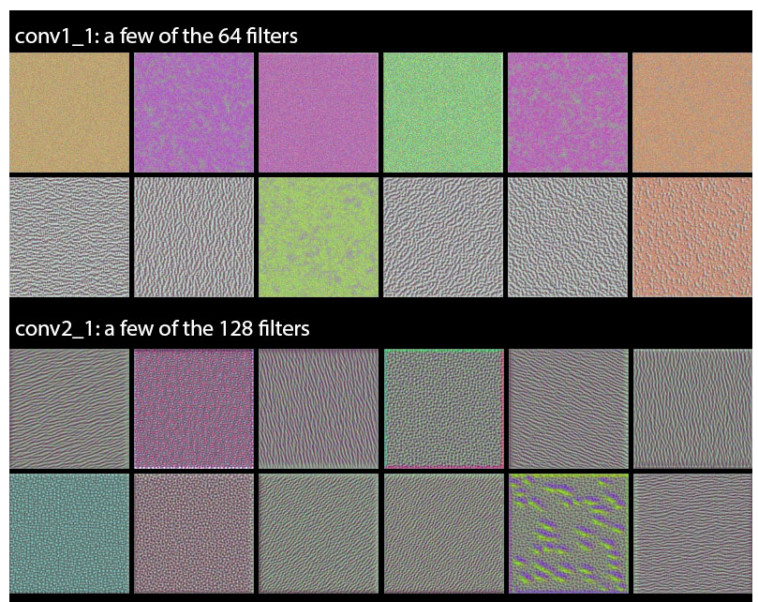
1 - Transfer Learning
AI VIETNAM
All-in-One Course
Neural Network Layers: General to specific
Bottom/first/earlier layers: general learners
Low-level: edges, visual shapes
Top/last/later layers: specific learners
High-level features: eyes, feathers
Earlier layers

Slide 5
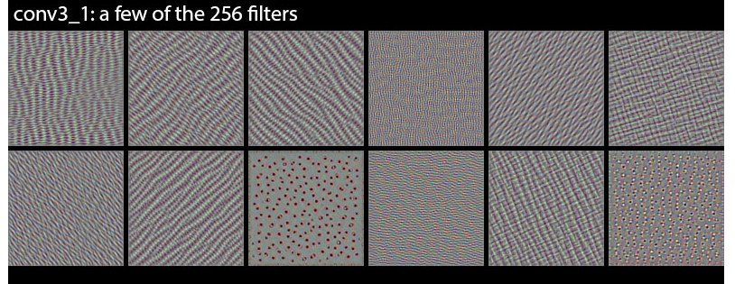
1 - Transfer Learning
AI VIETNAM
All-in-One Course
Neural Network Layers: General to specific
Bottom/first/earlier layers: general learners
Low-level: edges, visual shapes
Top/last/later layers: specific learners
High-level features: eyes, feathers
Mid layers

Slide 6


1 - Transfer Learning
AI VIETNAM
All-in-One Course
Neural Network Layers: General to specific
Earlier layers
ImageNet
Pill data

Slide 7
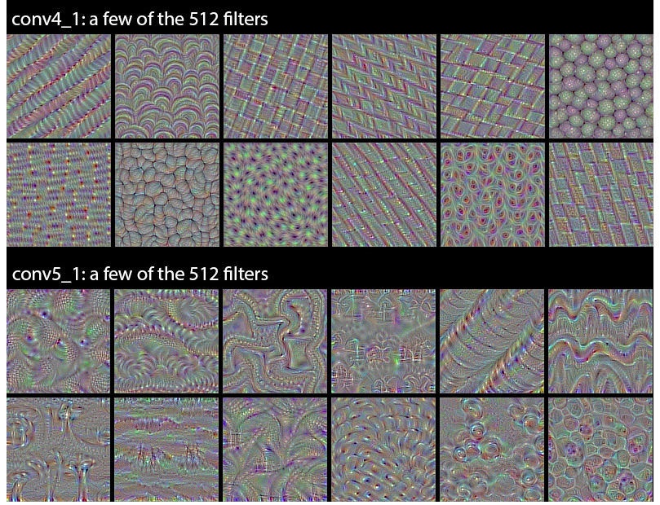
1 - Transfer Learning
AI VIETNAM
All-in-One Course
Neural Network Layers: General to specific
Bottom/first/earlier layers: general learners
Low-level: edges, visual shapes
Top/last/later layers: specific learners
High-level features: eyes, feathers
Later layers

Slide 8
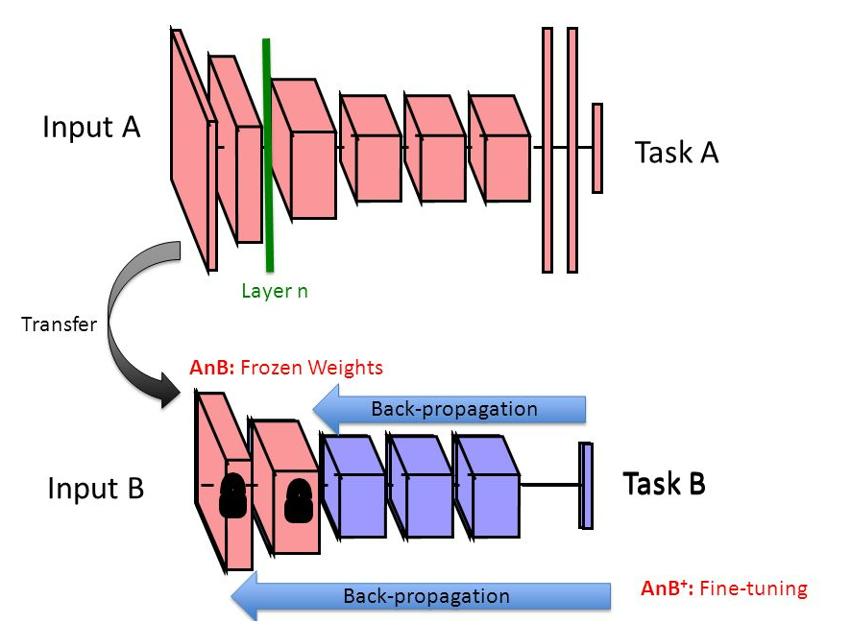
1 - Transfer Learning
AI VIETNAM
All-in-One Course
Transfer Learning: Overview

Slide 9
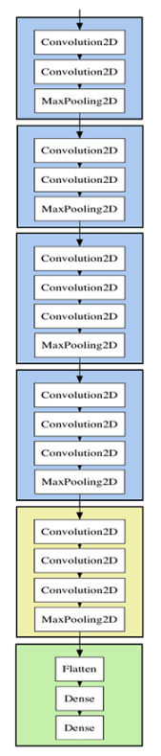
1 - Transfer Learning
AI VIETNAM
All-in-One Course
Transfer Learning: Process
Conv Block 1: Frozen
Start with pre-trained network
Partition network into
Featurizers: Identify which layer to keep
Classifiers: Identify which layer to replace
Re-train classifier layers with new data
Unfreeze weights and fine-tun whole network
with smaller learning rate
Conv Block 2: Frozen
Conv Block 3: Frozen
Conv Block 4: Frozen
Which layers to re-train?
Depends on the domain
Start by re-training the last layers
Work backwards if performance is not satisfactory
Conv Block 5: Fine-tune
Our Fully connected Cls

Slide 10
1 - Transfer Learning
AI VIETNAM
All-in-One Course
When and how to fine-tune?
Dataset size | Dataset similarity | Recommendation
Large | Very different | Train model B from scratch Initalize weights from model A
Large | Similar | OK to fine-tune (less likely to overfit)
Small | Very different | Train classifier using the earlier layers
Small | Similar | Don't fine-tune (overfitting). Train a linear classifier

Slide 11
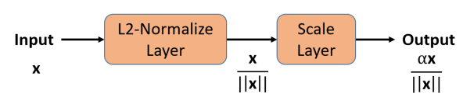
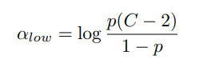
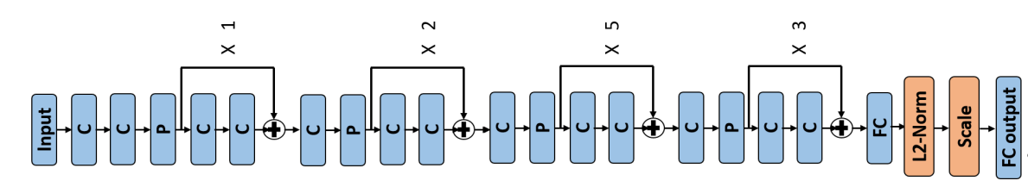
2 - Normalize
AI VIETNAM
All-in-One Course
p: xác suất của lần train trước đó
C: số lượng Class
Thêm normalize layer để chuẩn hóa feature

Slide 12
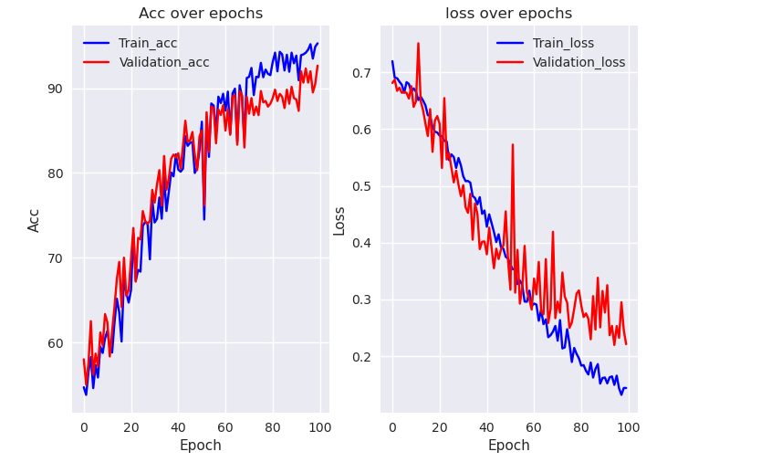
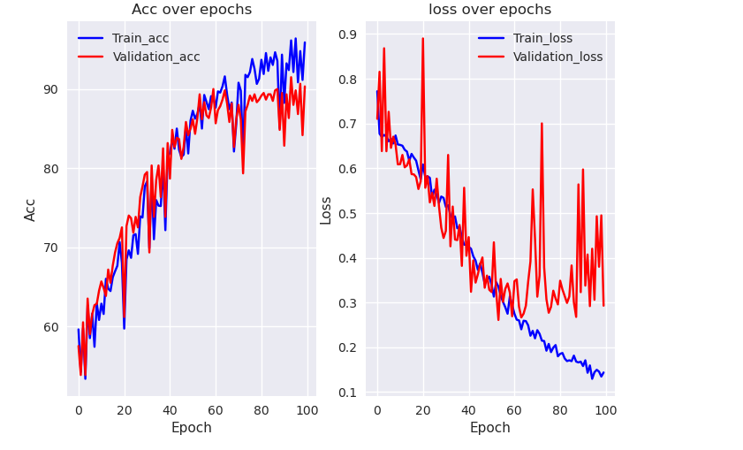
2 - Normalize
AI VIETNAM
All-in-One Course
With Normalize
Without Normalize

Slide 13

3 - Prevents CUDA Error: Out of Memory
AI VIETNAM
All-in-One Course
Koila: a light-weight wrapper over native PyTorch.
Automatically computes the amount of remaining GPU memory and uses the right batch size, saving everyone from having to manually fine-tune the batch size whenever a model is used.

Slide 14
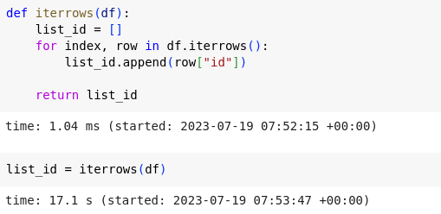
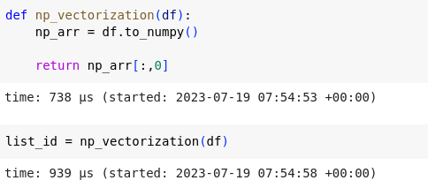
4 - Iterate over rows in dataframe
AI VIETNAM
All-in-One Course
Pandas vectorization far outperforms Pandas iterrows for computing stuff with dataframes.

Slide 15
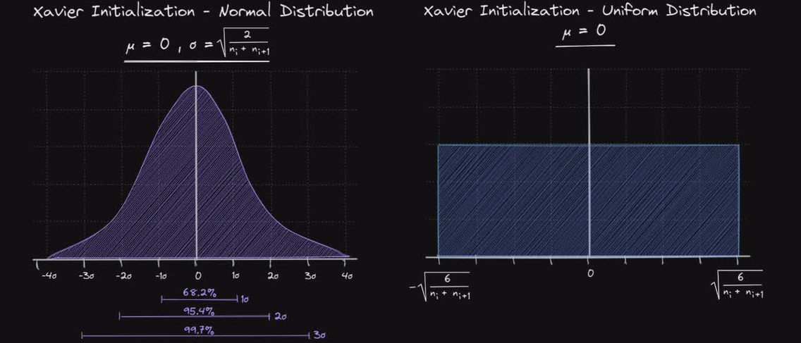
5 - Xavier Init
AI VIETNAM
All-in-One Course
Weight initialization is an important consideration in the design of a neural network model.
The nodes in neural networks are composed of parameters referred to as weights used to calculate a weighted sum of the inputs.
The xavier initialization method is calculated as a random number with a uniform probability distribution (U) between the range [-(1/sqrt(n)), 1/sqrt(n)], where n is the number of inputs to the node.

Slide 16
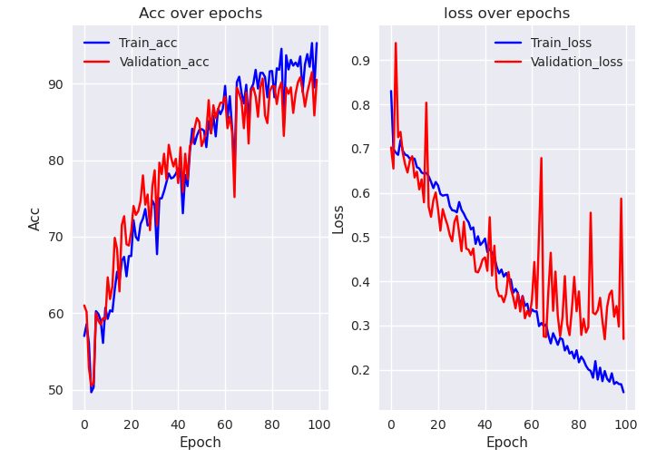
5 - Xavier Init
AI VIETNAM
All-in-One Course
Baseline
Baseline + Xavier

Slide 17
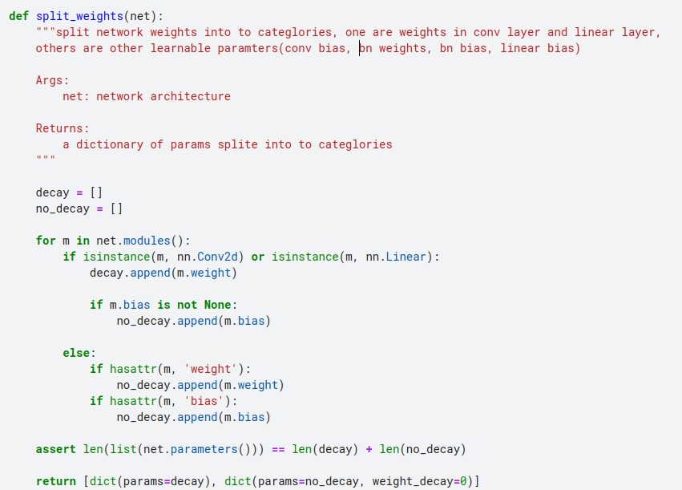
6 - No bias decay
AI VIETNAM
All-in-One Course

Slide 18
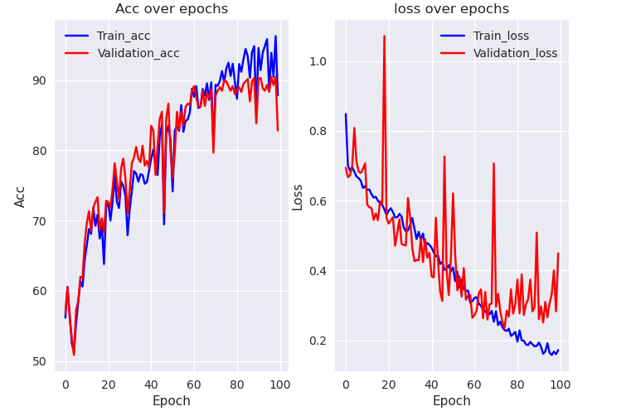
6 - No bias decay
AI VIETNAM
All-in-One Course
Baseline
Baseline + Xavier
+ No bias decay

